Slide 1






Statistical Analysis On Pattern of Accidents in USA

Slide 2
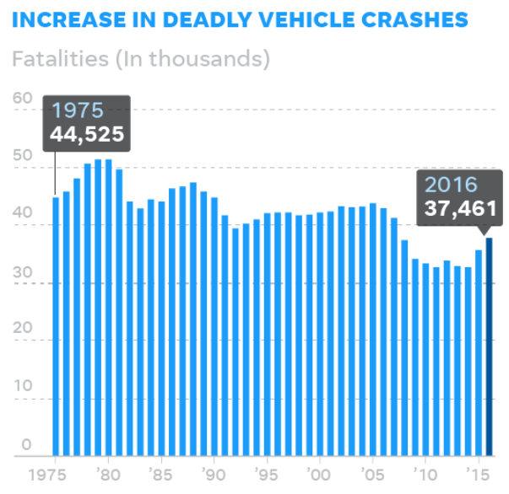

Spiked for a second straight year in 2016, hitting a nine-year high despite the adoption of new safety features and investments in partially self-driving cars.

Slide 3
Our Attempt
Statistics analysis primarily on the FARS Fatal Accident dataset as an attempt to address this problem.
The relationship between fatal rate and other attributes including collision manner, weather, light condition, seat position, Manufacturing year of car and drunk driver were investigated.
Certain safety driving suggestions were made based on the statistical analysis.

Slide 4


How Good Is The Weather To Drive?

Slide 5
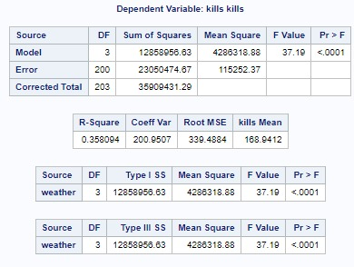
Test Conducted: One – Way Anova
Dependent variable : Number of Fatal Accidents
Categorical Variable : Weather
Null Hypothesis : Means for all weather conditions are equal
Alternate hypothesis : Means for at least one weather condition isn’t equal

Slide 6
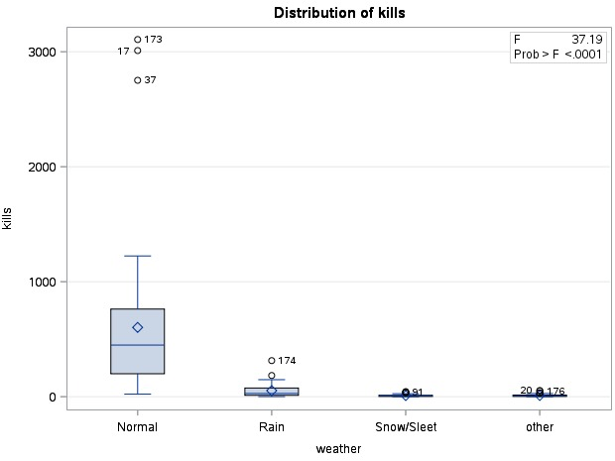
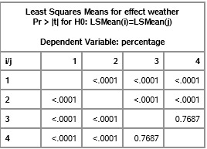
Normal Weather Conditions have more number of Accidents when compared to a bad weather day.

Slide 7
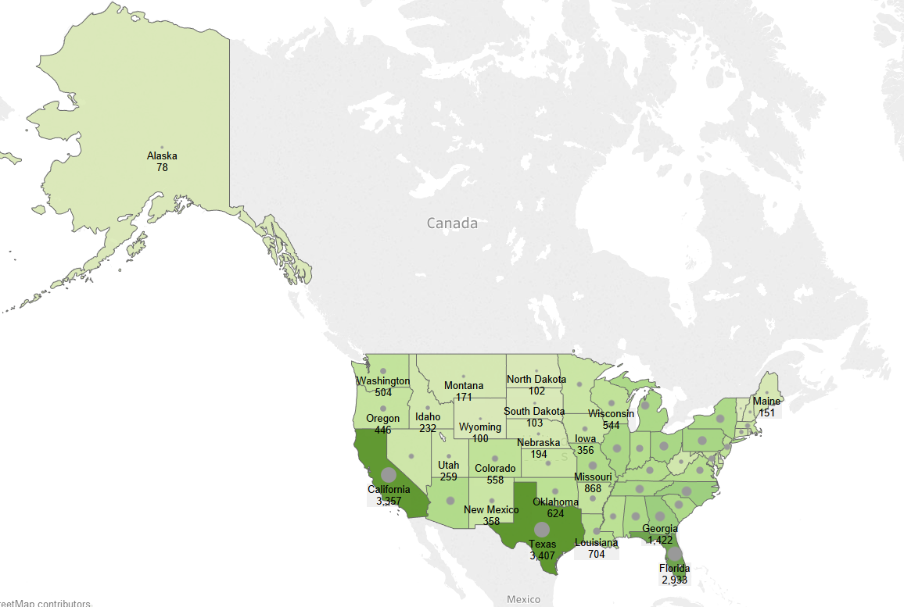
Number of Accidents

Slide 8

Clustering The States

Slide 9
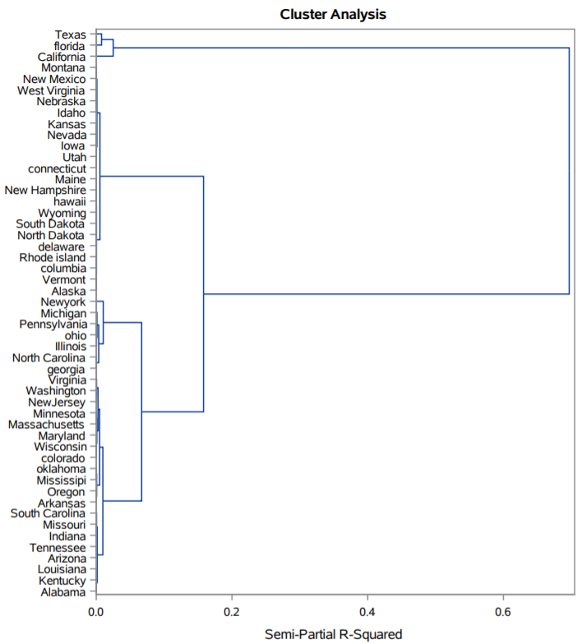
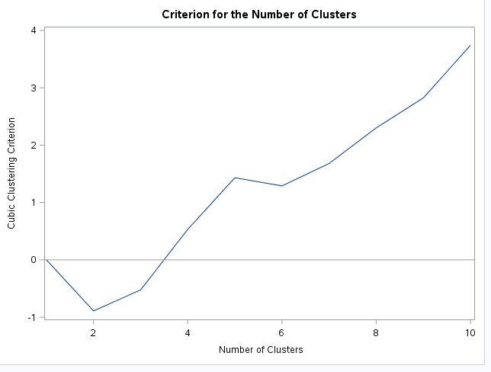

Slide 10
Grouping states based on the clusters
Cluster 1: Texas, Florida, California
Cluster 2: Georgia, Illinois, Michigan, New York, North Carolina, Ohio, Pennsylvania, Tennessee
Cluster 3: Alabama, Alaska, Arizona, Arkansas, Colorado, Connecticut, Delaware, Columbia, Hawaii, Idaho, Indiana, Iowa, Kansas, Kentucky, Louisiana, Maine, Maryland, Massachusetts, Minnesota, Mississippi, Missouri, Montana, Nebraska, Nevada, New Hampshire, New Jersey, New Mexico, North Dakota, Oklahoma, Oregon, ode island, South Carolina, South Dakota, Utah, Vermont, Virginia, Washington, West Virginia, Wisconsin, Wyoming

Slide 11
Fatality: It is an occurrence of death by accident
Fatality Rate: (Total number of fatal accidents by state)/ (state’s total population)

Slide 12
Conclusion
Cluster 1 has the highest number in population and also have higher number of fatal accidents. Considering the fatality rate vs population we can say that group 1 states are safer
Cluster 2 has medium fatality rate when compared to the states in cluster 3
Cluster 3 has low population and at the same time they have significantly high number of fatal accidents. Hence considering the fatality rates the cluster 3 states are the more accident prone states which can be fatal

Slide 13
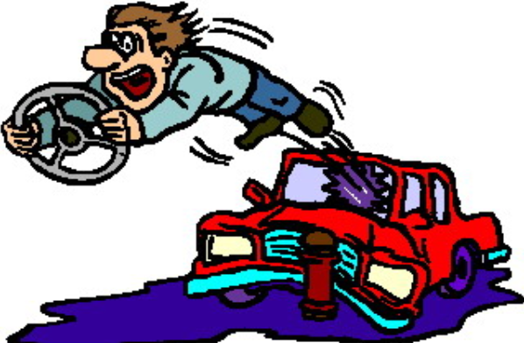
Factors Affecting the Safety Of The Driver

Slide 14
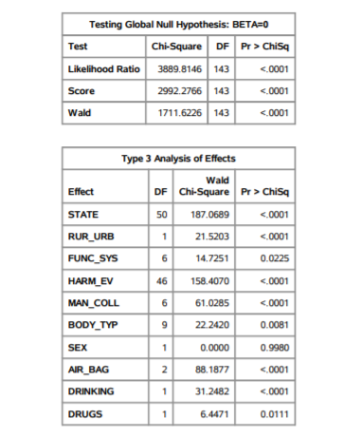
Significant variables
FUNC_SYS- Type of road
MAN_COLL
HARM_EV
BODY_TYPE

Slide 15
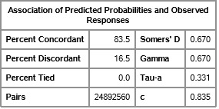
Hatch backs are more prone to accidents
Vehicles hitting in Opposite Direction are more dangerous
For every unit increase in Age of the Car person being dead increases by 5 percent

Slide 16

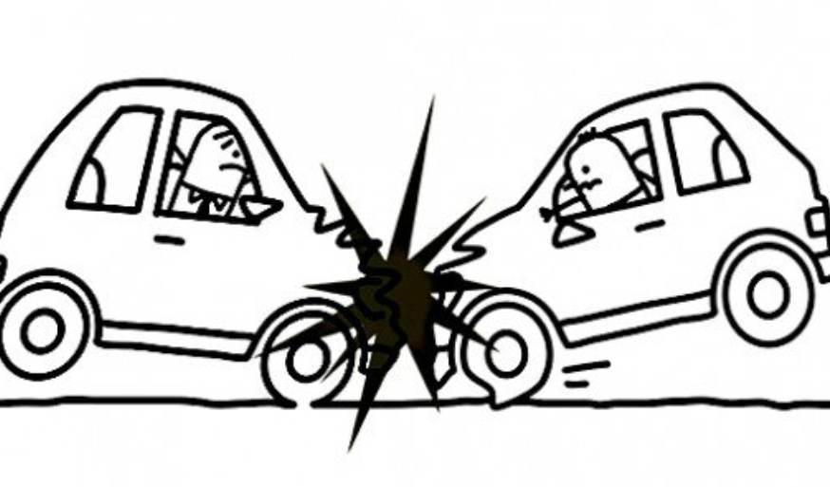


Can Economy Effect The Number of Accidents?

Slide 17
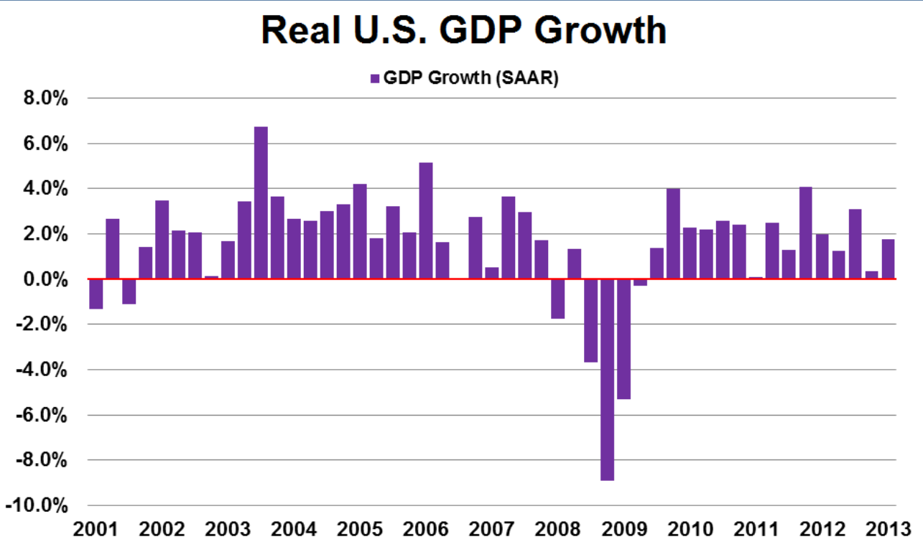
Variables considered : GDP, Unemployment Index, Alcohol Consumption, Smoking
Test Conducted : Multiple Linear Regression

Slide 18
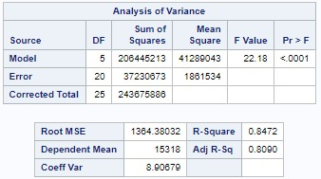
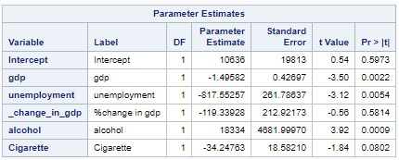
Significant variables :
Unemployment
Alcohol Consumption Rate
GDP

Slide 19
THANK YOU

